Slide 1
Urban Data Labs Dashboard Proposal Presentation
Data 599 Mitch Harris, Ryan Koenig, Nathan Smith May 11, 2021

Slide 2
Outline
1. Urban Data Labs
2. Project Overview
3. Project Management
4. Next Steps

Slide 3
Urban Data Labs

Slide 4
Project Overview
Building sensor data streaming anomaly detection with final product as a dashboard

Slide 5
Project Overview Background

Slide 6
Project Overview Approach

Slide 7
Project Overview Schedule

Slide 8
Project Management
Approach
Meetings / Communication
Description of Tools

Slide 9
Project Management Approach

Slide 10
Project Management Meetings / Communication

Slide 11
Project Management Description of Tools

Slide 12
Project Status
Previous Week Summary (May 3-9)
Next Steps (May 10-16)

Slide 13
Project Status Previous Week Tasks
Initial kick-off meeting with UDL (Mon May 3)
Second meeting with UDL based on Building Project selection
Set up project templates (meeting minutes, logs, team document)
Kanban board project management setup including project schedule
Proposal, including:
Project background
Urban Data Labs review
Proposal presentation

Slide 14
Project Status Previous Week Time Summary

Slide 15
Project Status Next Steps
Project Research
Review of current system architecture (Mitch)
Anomaly detection algorithms/approaches (Nate)
Discussion with domain experts (All)
Azure Learning (Ryan)
Get up to speed with data currently in Azure
Start determining what will need to be added to support this project
Initial Discussion on Dashboard Layout (All)

Slide 16
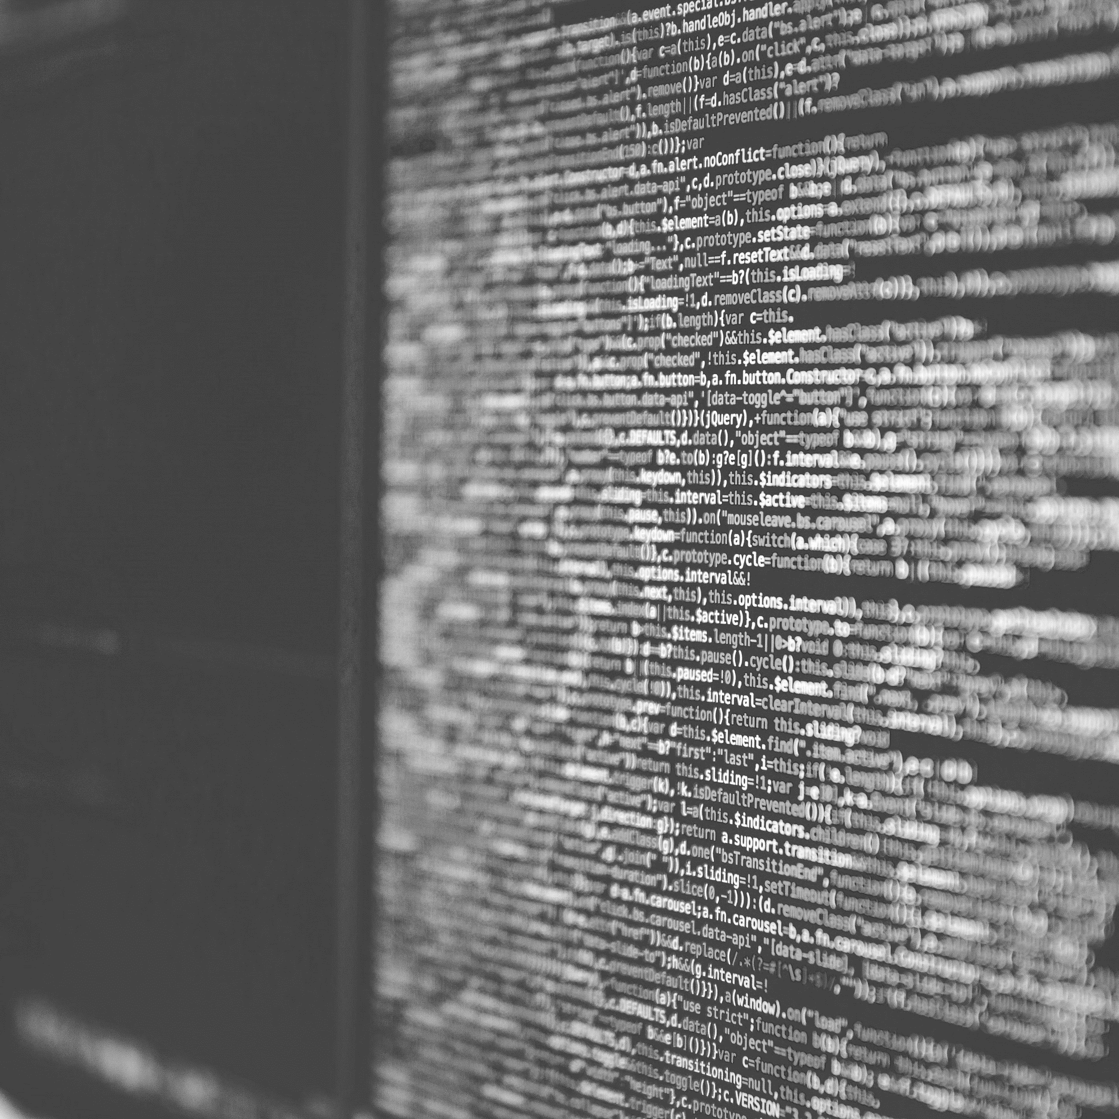
Q&A
Mitch Harris
Ryan Koenig
Nathan Smith
Photo by Markus Spiske on Unsplash

